Slide 1
The Battle of Neighborhoods – Final Report
Business Goal
Data Set
Methodology
Results and Limitations

Slide 2
What was analyzed?
The Nuremberg Metropolitan Region comprises 3.5 million people on 21,800 square kilometers. It consists of the cities of Nuremberg, Fürth, Erlangen, Bayreuth and Bamberg and is one of Germany’s strongest economic areas. Due to a decline in historically prevalent industry, such as consumer electronics the area has lacked behind in economic development compared to other more famous German regions, such as Munich or Stuttgart.
However, this is also means that real estate and wages are lower compared to its contemporaries. Thus, potential investors find a large pool of well-educated workers, consumers and relatively cheap real estate.

Slide 3
Business Understanding & Problem
The optimal location for an investor would maximize population density, while minimizing real estate prices and competition. These values vary significantly from district to district and from city to city.
Therefore, we want to create a map, which charts all areas according to its real estate values, population and venue density. The features targeted in this model are the following:
The density of competitors (number of venues)
Investment expenses (Average price per SQM)
Potential customers (total population & population density)

Slide 4
Data Description
The following data sources were identified to tackle the business problem:
The number of venues within the certain radius of each district (Foresquare API)
The net income per citizen per district. Source:
http://www.boeckler.de/pdf/wsi_vm_verfuegbare_einkommen.xlsx
The population and the population density of the district. Source:
http://www.daten.statistik.nuernberg.de/geoinf/ia_bezirksatlas/atlas.html
The housing prices per district. Source:
https://www.wohnungsboerse.net/mietspiegel-Nuernberg/2176
The coordinates of each district. Source: Open Street Map
https://nominatim.openstreetmap.org/ui/search.html?q=nuremberg

Slide 5
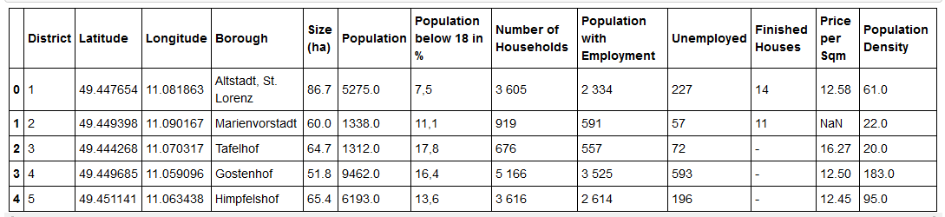
Data Set
After cleaning and preparing the data, the following data frame (master) was created, by merging either on the district or on the name of the Borough:

Slide 6
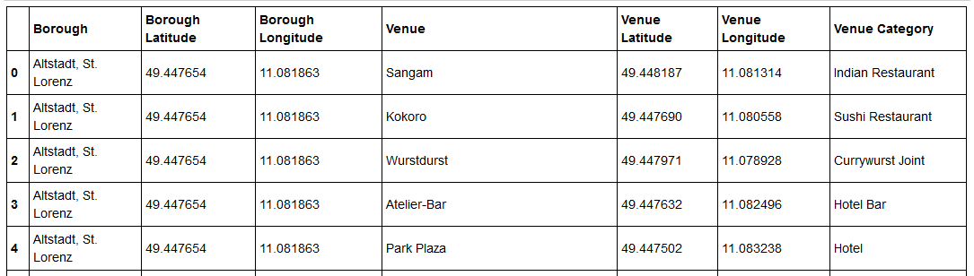
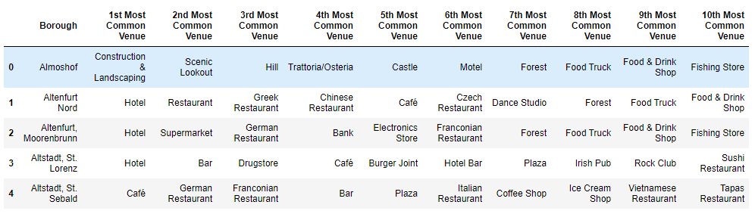
Data Set
The Foursquare API to explore the boroughs and segment them. I designed the limit as 300 venues and the radius of 500 meter for each borough from their given latitude and longitude information’s. Here is a head of the list Venues name, category, and latitude and longitude information’s from the Foursquare API:

Slide 7
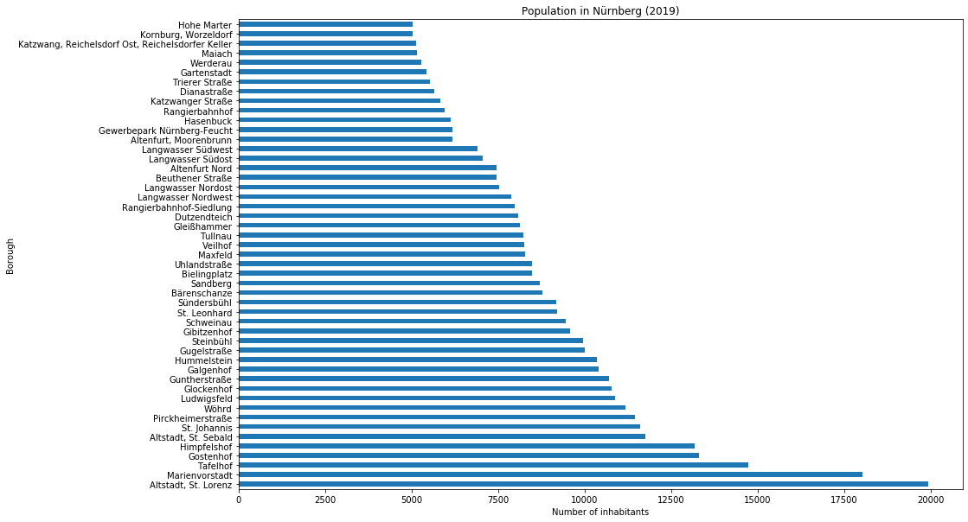
Exploratory Data Analysis (1)

Slide 8
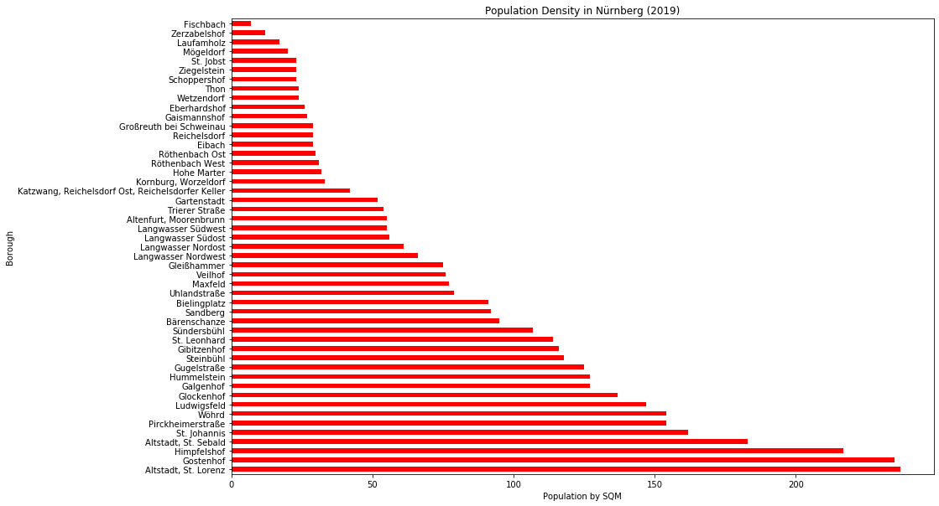
Exploratory Data Analysis (2)

Slide 9
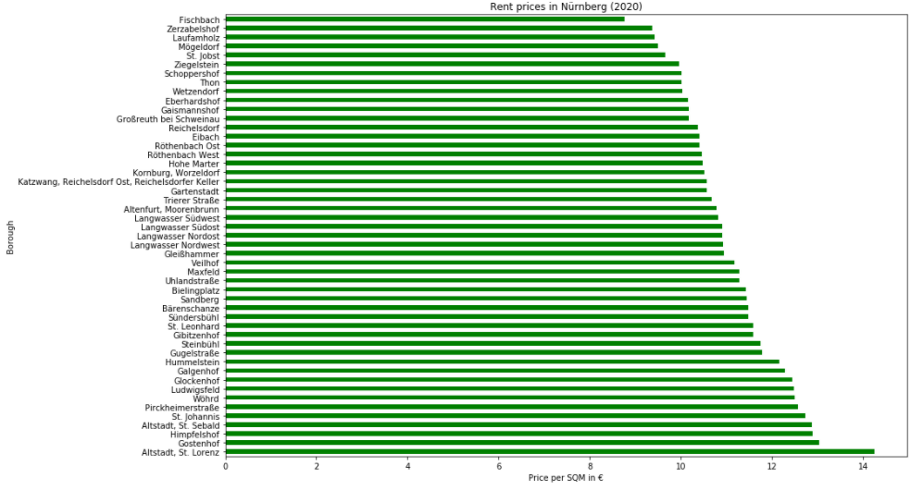
Exploratory Data Analysis (3)

Slide 10
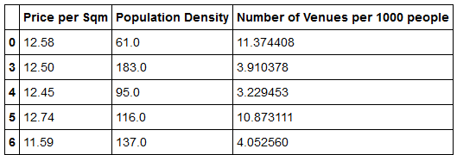
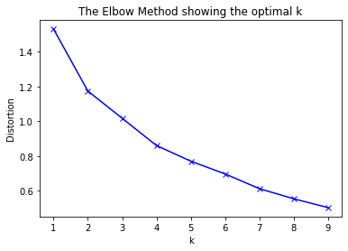
Clustering
In order to identify groups (clusters) with similar characteristics, the unsupervised machine learning method of clustering (K-Means) will be applied to the data set.
Dimensionality was reduced and variables were normalized. The elbow method was used, in order to determine 4 optimal clusters:

Slide 11
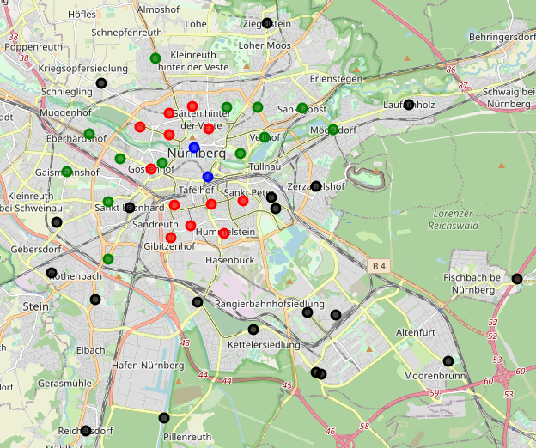
Applying Clustering to the Map of Nürnberg

Slide 12
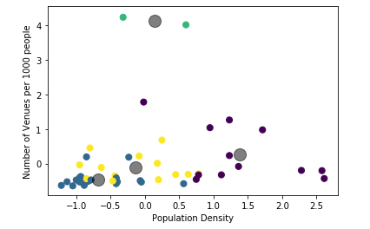
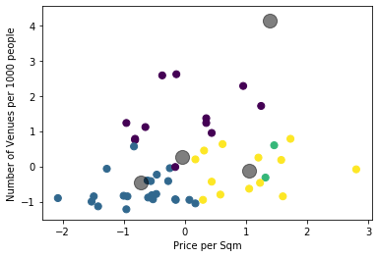
Analyzing the Clusters (1)
In order to compare clusters on the independent variables, scatter plots were created. (Purple = Red; Blue = Green; Black = Blue; Green = Yellow). The grey circle represents the centroid of each cluster. The data is normalized; therefore, it does not indicate real values:

Slide 13
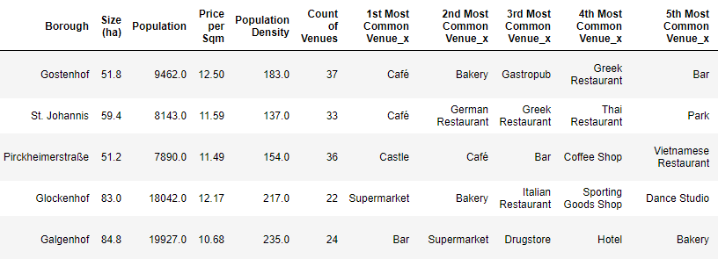
Analyzing the Clusters (2)
In order to better understand the indivual clusters the most common venues per Borough were added to a final data frame.
This combines all gathered and relevant information for each cluster and each Borough. As can be seen Glockenhof and Galgenhof have a high population density of over 200 people per Hektar and are comparatively cheap:

Slide 14
Conclusion
To conclude, the data sets were scrapped from public sources, loaded into data frames, cleaned and combined into usable data frames ready for analysis. Exploratory data analysis was done in order to understand the data and find angles for later analysis. The data was then reduced to its most important components and clustered, in order to find the optimal areas for business opportunities. Lastly, the red cluster was chosen as a pool of potential locations. On first glance, the Boroughs of Glockenhof or Galgenhof seem promising.

Slide 15
Limitation
A point of improvement would be full access to the foursquare library, in order to escape current limitations. Furthermore, foursquare doesn't represent the full amount of venues, since many venues are not on the listed. Therefore, another map could be utilized such as Google map or Open street map. Moreover, districts have a complex geometry, thus defining the closest venues within the certain radius brings additional error to our analysis.
Lastly, the income and therefore purchasing power of the population was not publicly available by cluster. Adding this feature would greatly improve the model.

Slide 16
Thank you!

